Slide 1
On Map-Matching
Vehicle Tracking Data
Sotiris Brakatsoulas
Dieter Pfoser
{sbrakats|pfoser}@cti.gr
Carola Wenk
Randall Salas
{wenk|rsalas}@cs.utsa.edu

Slide 2

Motivation
Moving Objects Data
Vehicle Tracking Data
Trajectories

Slide 3
Motivation
Use of Floating Car Data (FCD) generated by vehicle fleet as samples to assess to overall traffic conditions
Floating car data (FCD)
  basic vehicle telemetry, e.g., speed, direction, ABS use
  the position of the vehicle (→ tracking data) obtained by GPS tracking
Traffic assessment
  data from one vehicle as a sample to assess to overall
  traffic conditions – cork swimming in the river
  large amounts of tracking data (e.g., taxis, public transport, utility vehicles, private vehicles) → accurate picture of the traffic conditions

Slide 4
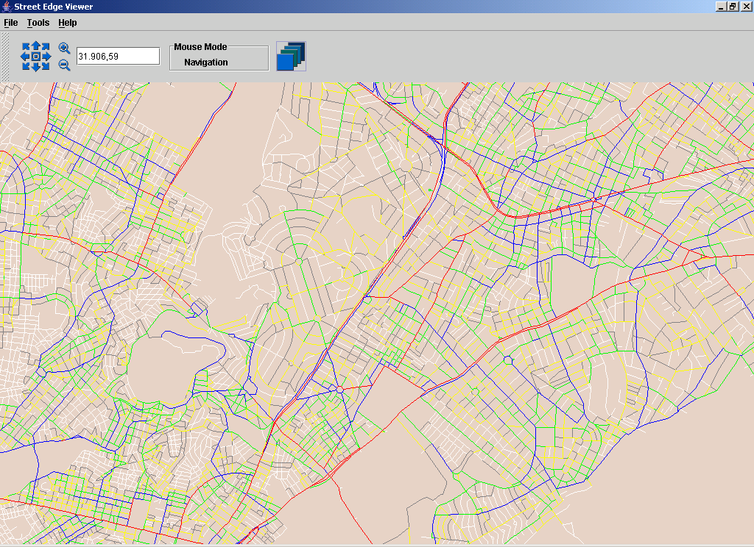
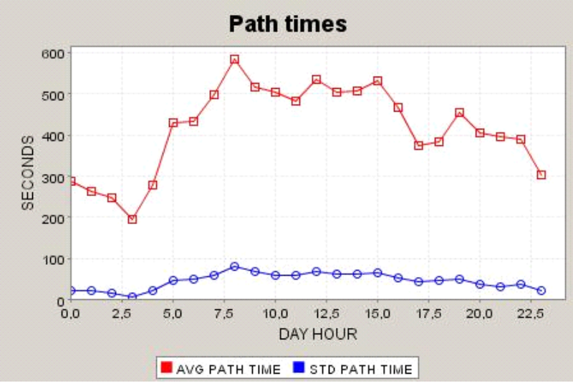
Traffic Condition Parameters
Traffic count
Travel times
Relating tracking data to road network → Map-Matching

Slide 5
Outline
Vehicle Tracking Data, Trajectories
  errors in the data
Incremental MM Technique
  “classical” approach
Global MM Technique
  curve – graph matching
Quality of the Map-Matching
  Measures
  Empirical Evaluation
Conclusions and future work

Slide 6
Vehicle Tracking Data
Sampling the movement
Sequence (temporal) of GPS points
  affected by precision of GPS positioning error
  measurement error
Interpolating position samples → trajectory
  affected by frequency of position samples
  sampling error
Notes:
show drawing here illustrating the possible error extents

Slide 7
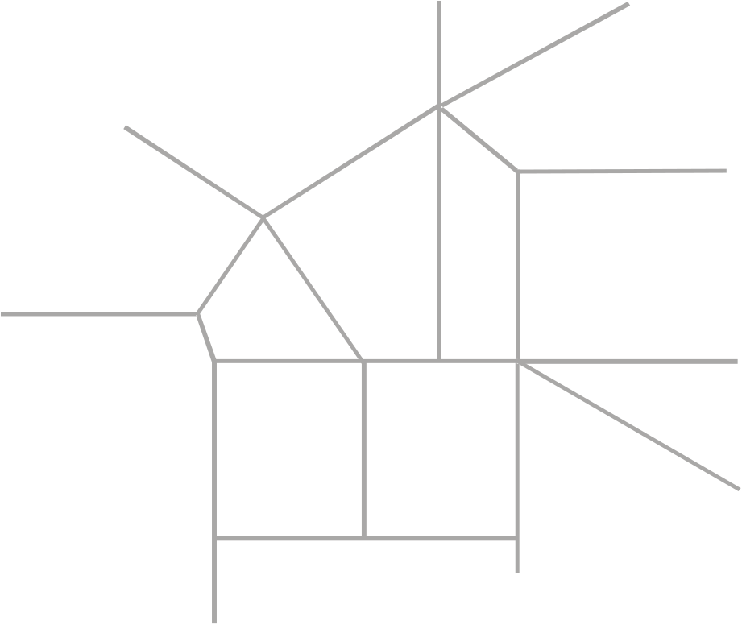
Vehicle Tracking Data
Error example
  vehicle speed 50km/h (max)
  sampling rate 30s
P₂
P₁
208m
Map-matching
  matching trajectories to a path in the road network
417m

Slide 8
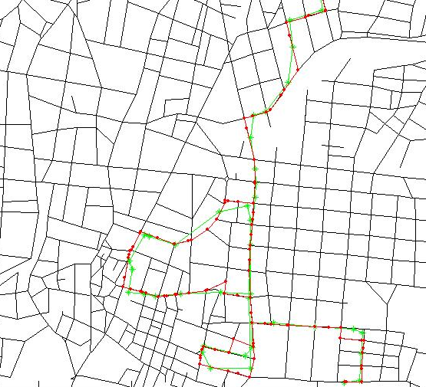
Map Matching
Perception of the problem
  online vs. offline map-matching
Incremental method
  incremental match of GPS points to road network edges
  classical approach
Global method
  matching a curve to a graph
  finding similar curve in graph

Slide 9



Incremental Method
Position-by-position, edge-by-edge strategy to map-matching
α
i,1
α
i,3
c
1
c
d
3
d
3
1
p
l
p
i
i-1
i
d
2
c
2
α
i,2
Notes:
maximum score and power parameter

Slide 10
Incremental Method
Introducing globality
Look-ahead to evaluate quality of different paths
  to match one edge consider its consequences
Example: depth = 2 (depth = 1 → no look-ahead)
c
1
c
3
p_{i}
p_{i-1}
c
2
p_{i+1}

Slide 11
Incremental Method
Actual map-matching
  evaluates for each trajectory edges (GPS point) a finite number of edges of the road network graph
  O(n) (n – trajectory edges)
Initialization done using spatial range query
Map-matching dominates initialization cost

Slide 12
Global Method
Try to find a curve in the road network (modeled as a graph embedded in the plane with straight-line edges) that is as close as possible to the vehicle trajectory
Curves are compared using
  Fréchet distance and
  Weak Fréchet distance
Minimize over all possible curves in the road network

Slide 13

Fréchet Distance
Dog walking example
  Person is walking his dog (person on one curve and the dog on other)
  Allowed to control their speeds but not allowed to go backwards!
  Fréchet distance of the curves: minimal leash length necessary for both to walk the curves from beginning to end

Slide 14
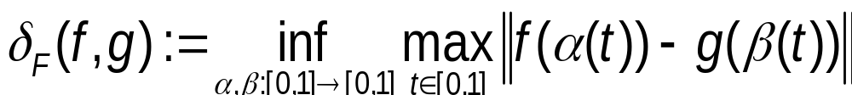
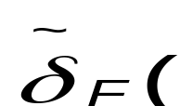
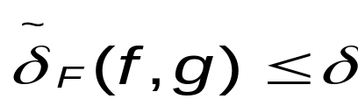
Fréchet Distance
Fréchet Distance
  where α and β range over continuous non-decreasing reparametrizations only
Weak Fréchet Distance
  drop the non-decreasing requirement for α and β
Well-suited for the comparison of trajectories since they take the continuity of the curves into account
Notes:
reparamterized monotonous curve

Slide 15
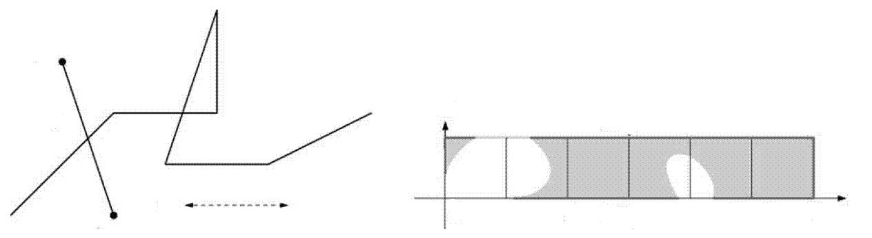
Free Space Diagram
Decision variant of the global map-matching problem
  for a fixed ε > 0 decide whether there exists a path in the road network with distance at most ε to the vehicle trajectory α
For each edge (i,j) in a graph G let its corresponding Freespace Diagram FD_{i,j} = FD(α, (i,j))
i
α
(i,j)
(i,j)
1
ε
0
1
2
3
4
5
6
α
j
Notes:
for each edge in the graph let

Slide 16
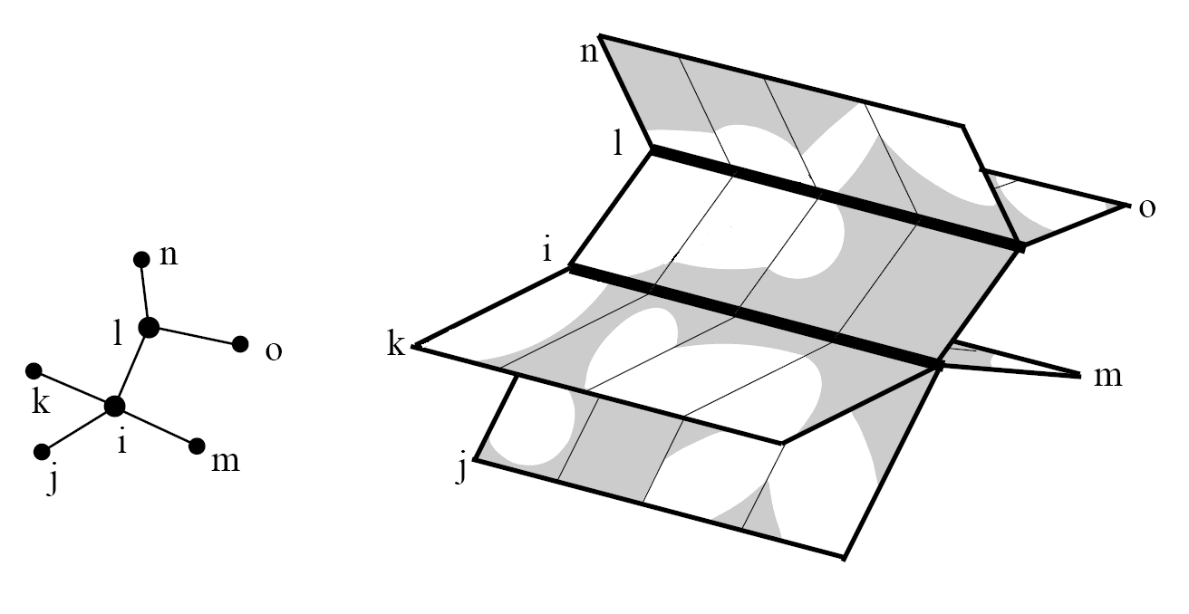
Free Space Surface
Glue free space diagrams FD_{i,j} together according to adjacency information in the graph G
Free space surface of trajectory α and the
graph G
G
α shown implicitely by the free space surface

Slide 17
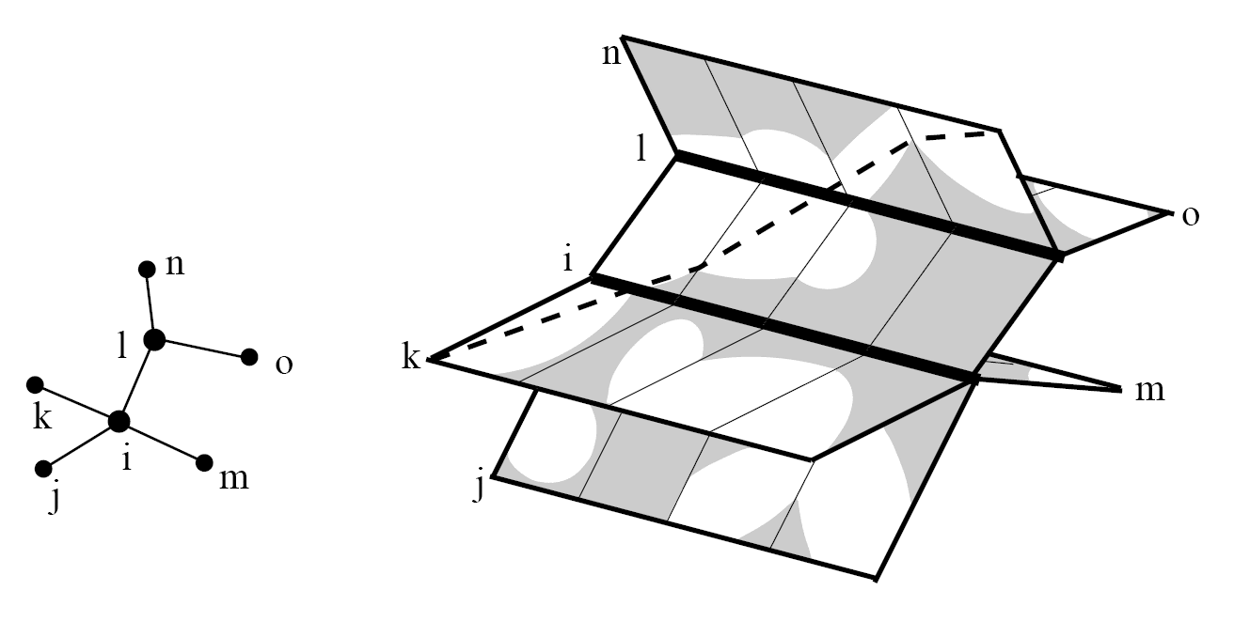
Free Space Surface
TASK: Find monotone path in free space surface
  starting in some lower left corner, and
  ending in some upper right corner
G

Slide 18
Free Space Surface
Sweep-line algorithm
  maintain points on sweep line that are reachable by some monotone path in the free space from some lower-left corner
  updating reachability information Dijkstra style
Minimization problem for ε is solved using parametric search or binary search
  Parametric search (binary search)
  O(mn log²(mn)) time
  (m – graph edges, n – trajectory edges)
  Weak Fréchet distance, drop monotone requirement
  O(mn log mn) time

Slide 19
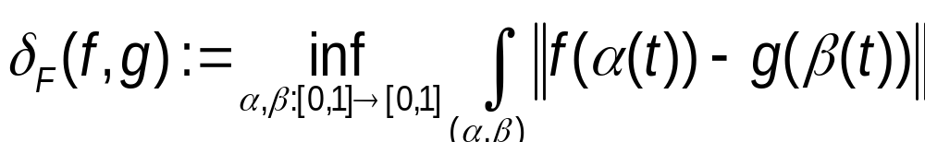
Quality of Matching Result
Comparing Fréchet distance of original and matched trajectory
Fréchet distances strongly affected by outliers, since they take the maximum over a set of distances.
How to fix it? Replace the maximum with a path integral over the reparametrization curve (α(t),β(t)):
  Remark: Dividing by the arclength of the reparametrization curve yields a normalization, and hence an „average“ of all distances.

Slide 20
Quality of Matching Result
Unfortunate drawbacks
  we do not know how to compute this integral.
Approximate integral by sampling the curves and computing a sum instead of an integral.
  2m
  very costly and gives no approximation guarantee or convergence rate

Slide 21
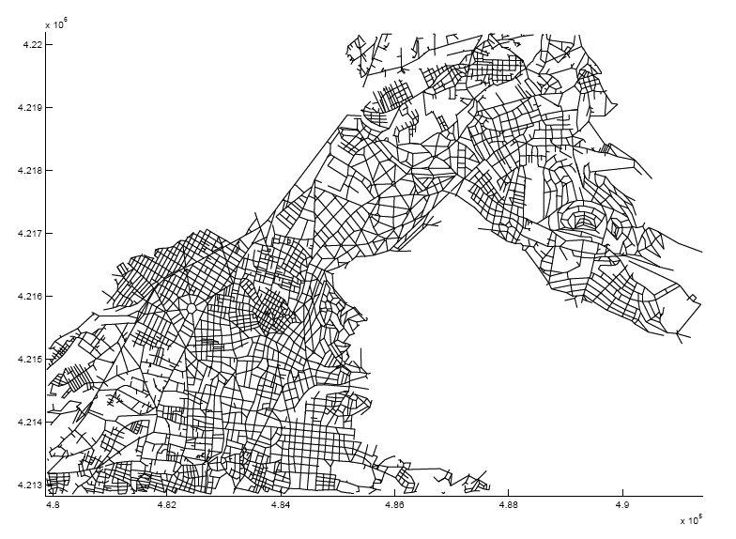
Empirical Evaluation
GPS vehicle tracking data
  45 trajectories
  (~4200 GPS points)
  sampling rate 30 seconds
Road network data
  vector map of Athens, Greece
  (10 x 10km)
Evaluating matching quality
  results from incremental vs. global method
  Fréchet distance vs. averaged Fréchet distance (worst-case vs. average measure)

Slide 22
Empirical Evaluation
Fréchet vs. Weak Fréchet distance produces same matching result
  no backing-up on trajectories (course sampling rate) or
  road network (on edge between intersections)

Slide 23
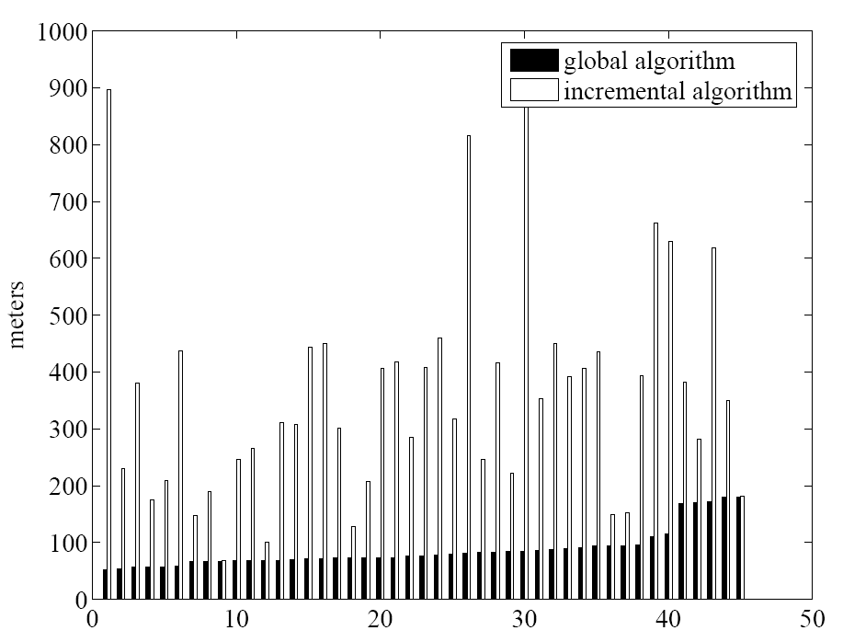
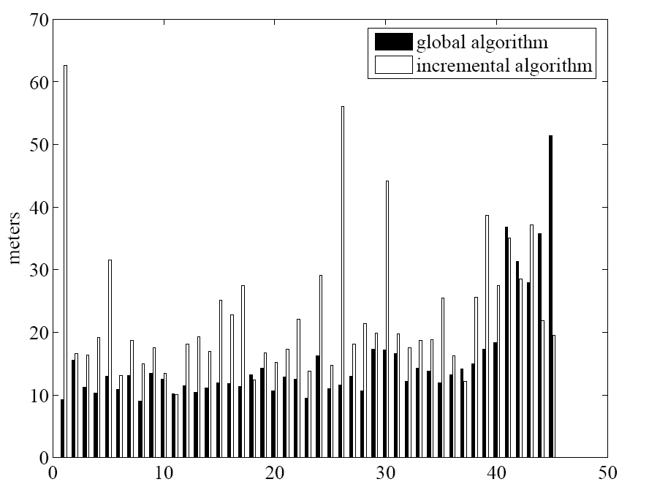
Empirical Evaluation
Global algorithm produces better results
Quality advantage reduced when using avg. Fréchet measure
Fréchet distance
Avg. Fréchet distance
Notes:
identical matching results
traps where the look-ahead to small to detect them

Slide 24
Conclusions
Offline map-matching algorithms
  Fréchet distance based algorithm vs. incremental algorithm
  accuracy vs. speed
  no difference between Fréchet and weak Fréchet algorithms in terms of matching results (data dependent)
Matching quality
  Fréchet distance strict measure
  Average Fréchet distance tolerates outliers

Slide 25
Future Work
Making the Fréchet algorithm faster!
  Exploit trajectory data properties (error ellipse) to limit the graph
  introduce locality
Other types of tracking data
  positioning technology (wireless networks, GSM, microwave positioning)
  type of moving objects (planes, people)
Data management for traffic management and control
Pathfinder Project
http://dke.cti.gr/chorochronos

Slide 26
Questions
|| open norm
reparametrizations
dynamic programming
Dijkstra
parametric search, binary search
complexity of the graph

Slide 27
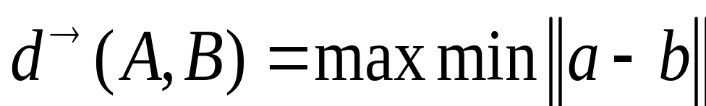
What does „similar“ mean?
Directed Hausdorff distance
d→(A,B) = max min || a-b ||
Undirected Hausdorff distance
  d(A,B) = max (d→(A,B) , d→(B,A) )
  But:
B
A
δ→(B,A)
δ→(A,B)
Small Hausdorff distance
When considered as curves the distance should be large
The Fréchet distance takes continuity of curves into account

Slide 28
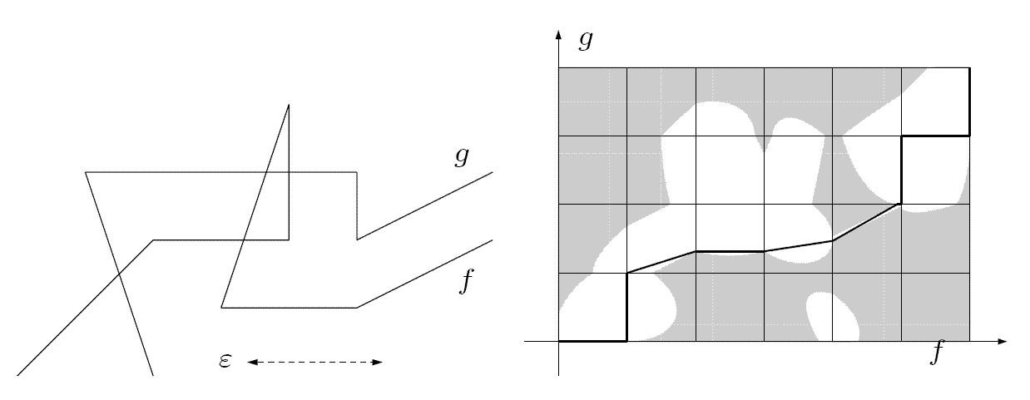
Free Space Diagram

Slide 29
Incremental Method
Depending on the type of projection/match of p_{i} to c_{j} , i.e.,
  (i) its projection is between the end points of c_{j} , or,
  (ii) it is projected onto the end points of the line segment,
the algorithm does, or does not advance to the next position sample.

Slide 30
Incremental Method
Introducing globality
Look-ahead to evaluate quality of different paths
Example: depth = 2 (depth = 1 → no look-ahead)
p_{i}
p_{i-1}
p_{i+1}

